Slide 1
EECT 121-50C Lab Notebook
Electronics Circuit Analysis
Spring 2016
Olivia Koehler

Slide 2
Table of Contents
Lab 0 – Function Generators and Oscilloscopes Pg. 3
Lab F₁ Pg. 10
Lab 1 - Diodes Pg. 15
Lab2 – Full and Half Wave Bridges Pg. 20
Lab 3 – LED’s Pg. 28
Lab 4 - +/- 9V Power Supplies Pg. 40
Lab 5 – NPN LED Switch 5V + 9V Pg. 47
Lab 6 – CE Transistor Pg. 53
Lab 7 – NPN LED Switch 2N2457 Pg. 75
Lab 8 – CE Transistor 2N5457 Pg. 83
Lab 9 – Filter Design Pg. 86
How to Find 2.5x Original Va Pg. 93
Supplementary Lessons Pg. 102

Slide 3
Lab 0 – Function Generators and Oscilloscopes

Slide 4
Lab 0 – Function Generators and Oscilloscopes
Objective
    1. To revisit using a function generator as well as an oscilloscope.
Equipment and Material
    Oscilloscope TDS 220
    Function Generator GFG-8210

Slide 5
Lab 0 – Function Generators and Oscilloscopes
Procedure
Hook up function generator to oscilloscope.
Change frequency from 100-1k Hz.
Measure Input and Output
Divide Input over Output

Slide 6
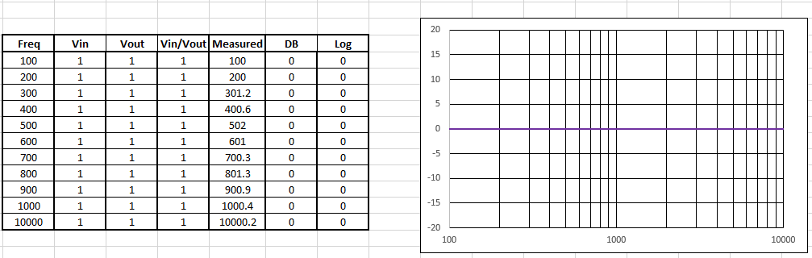
Lab 0 – Function Generators and Oscilloscopes
Excel

Slide 7
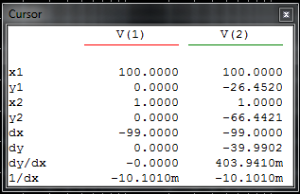
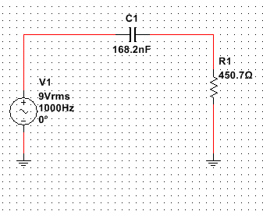
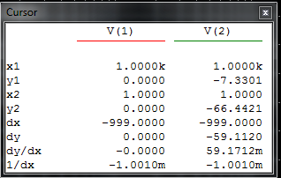
Lab 0 – Function Generators and Oscilloscopes

Slide 8
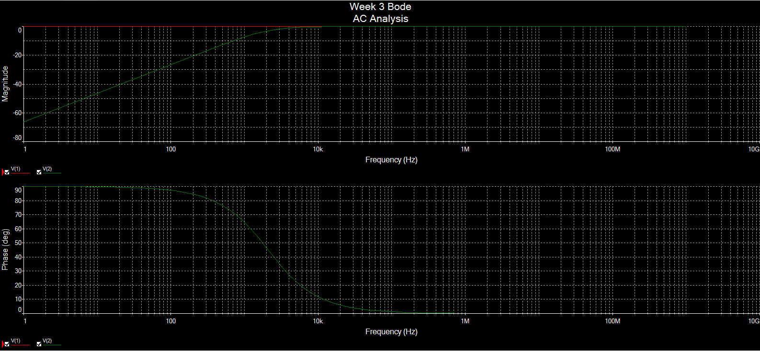
Lab 0 – Function Generators and Oscilloscopes

Slide 9
Lab 0 - Function Generators and Oscilloscopes
  Conclusion
  - Because nothing external was added to the voltage path, the input equaled the output every time.

Slide 10
Lab F₀

Slide 11
Objective
    1. To revisit using a function generator as well as an oscilloscope.
Equipment and Material
    Oscilloscope TDS 220
    Function Generator GFG-8210

Slide 12
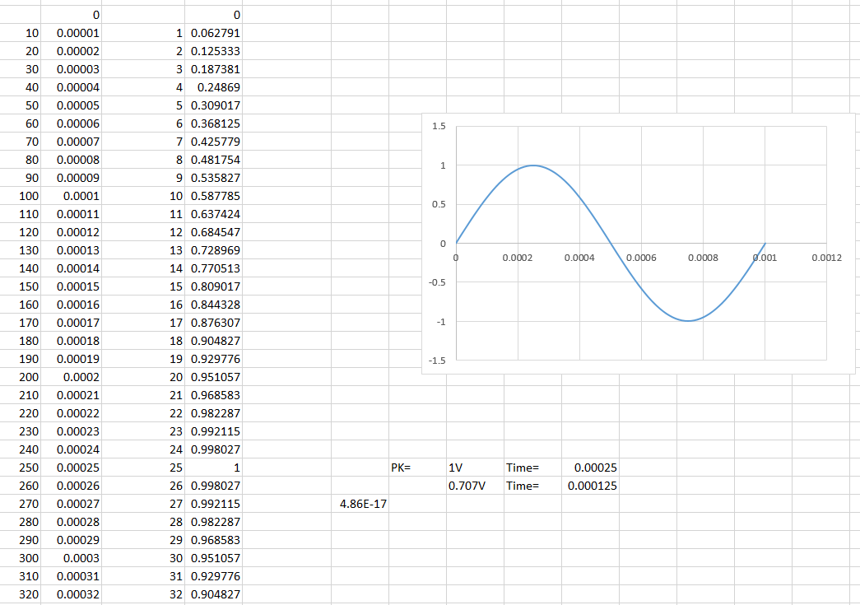
Lab F₁
Excel

Slide 13
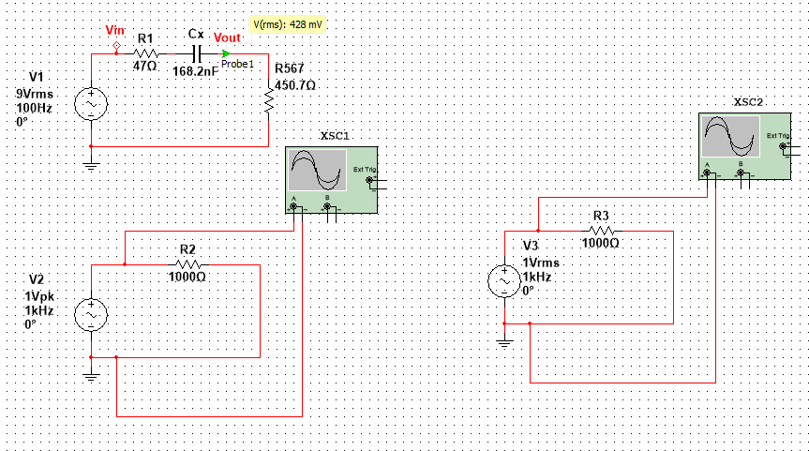
Lab F₀
Multisim

Slide 14
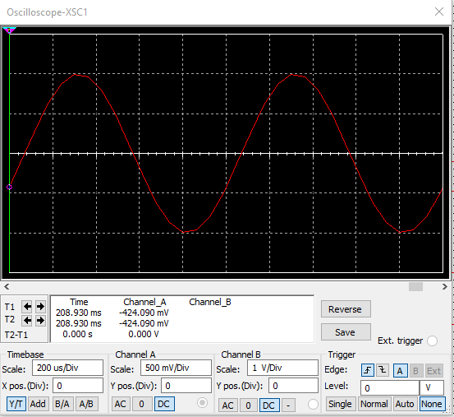
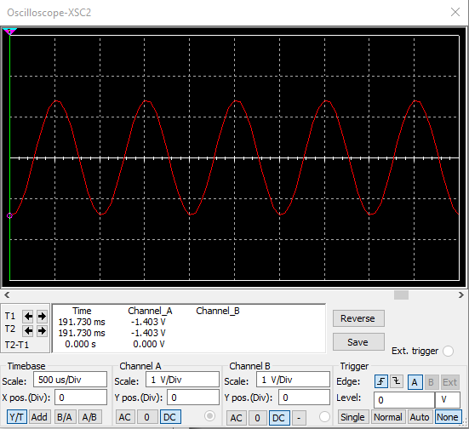
Lab F₀
Multisim

Slide 15
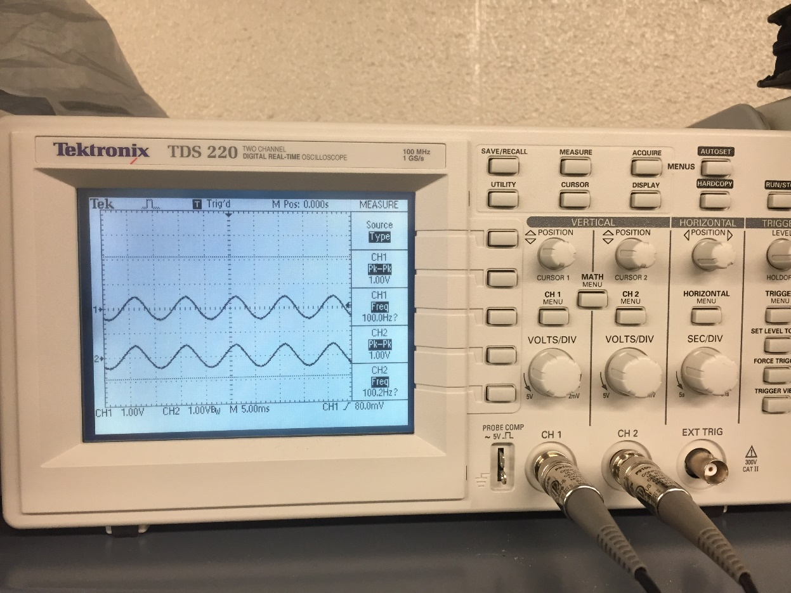
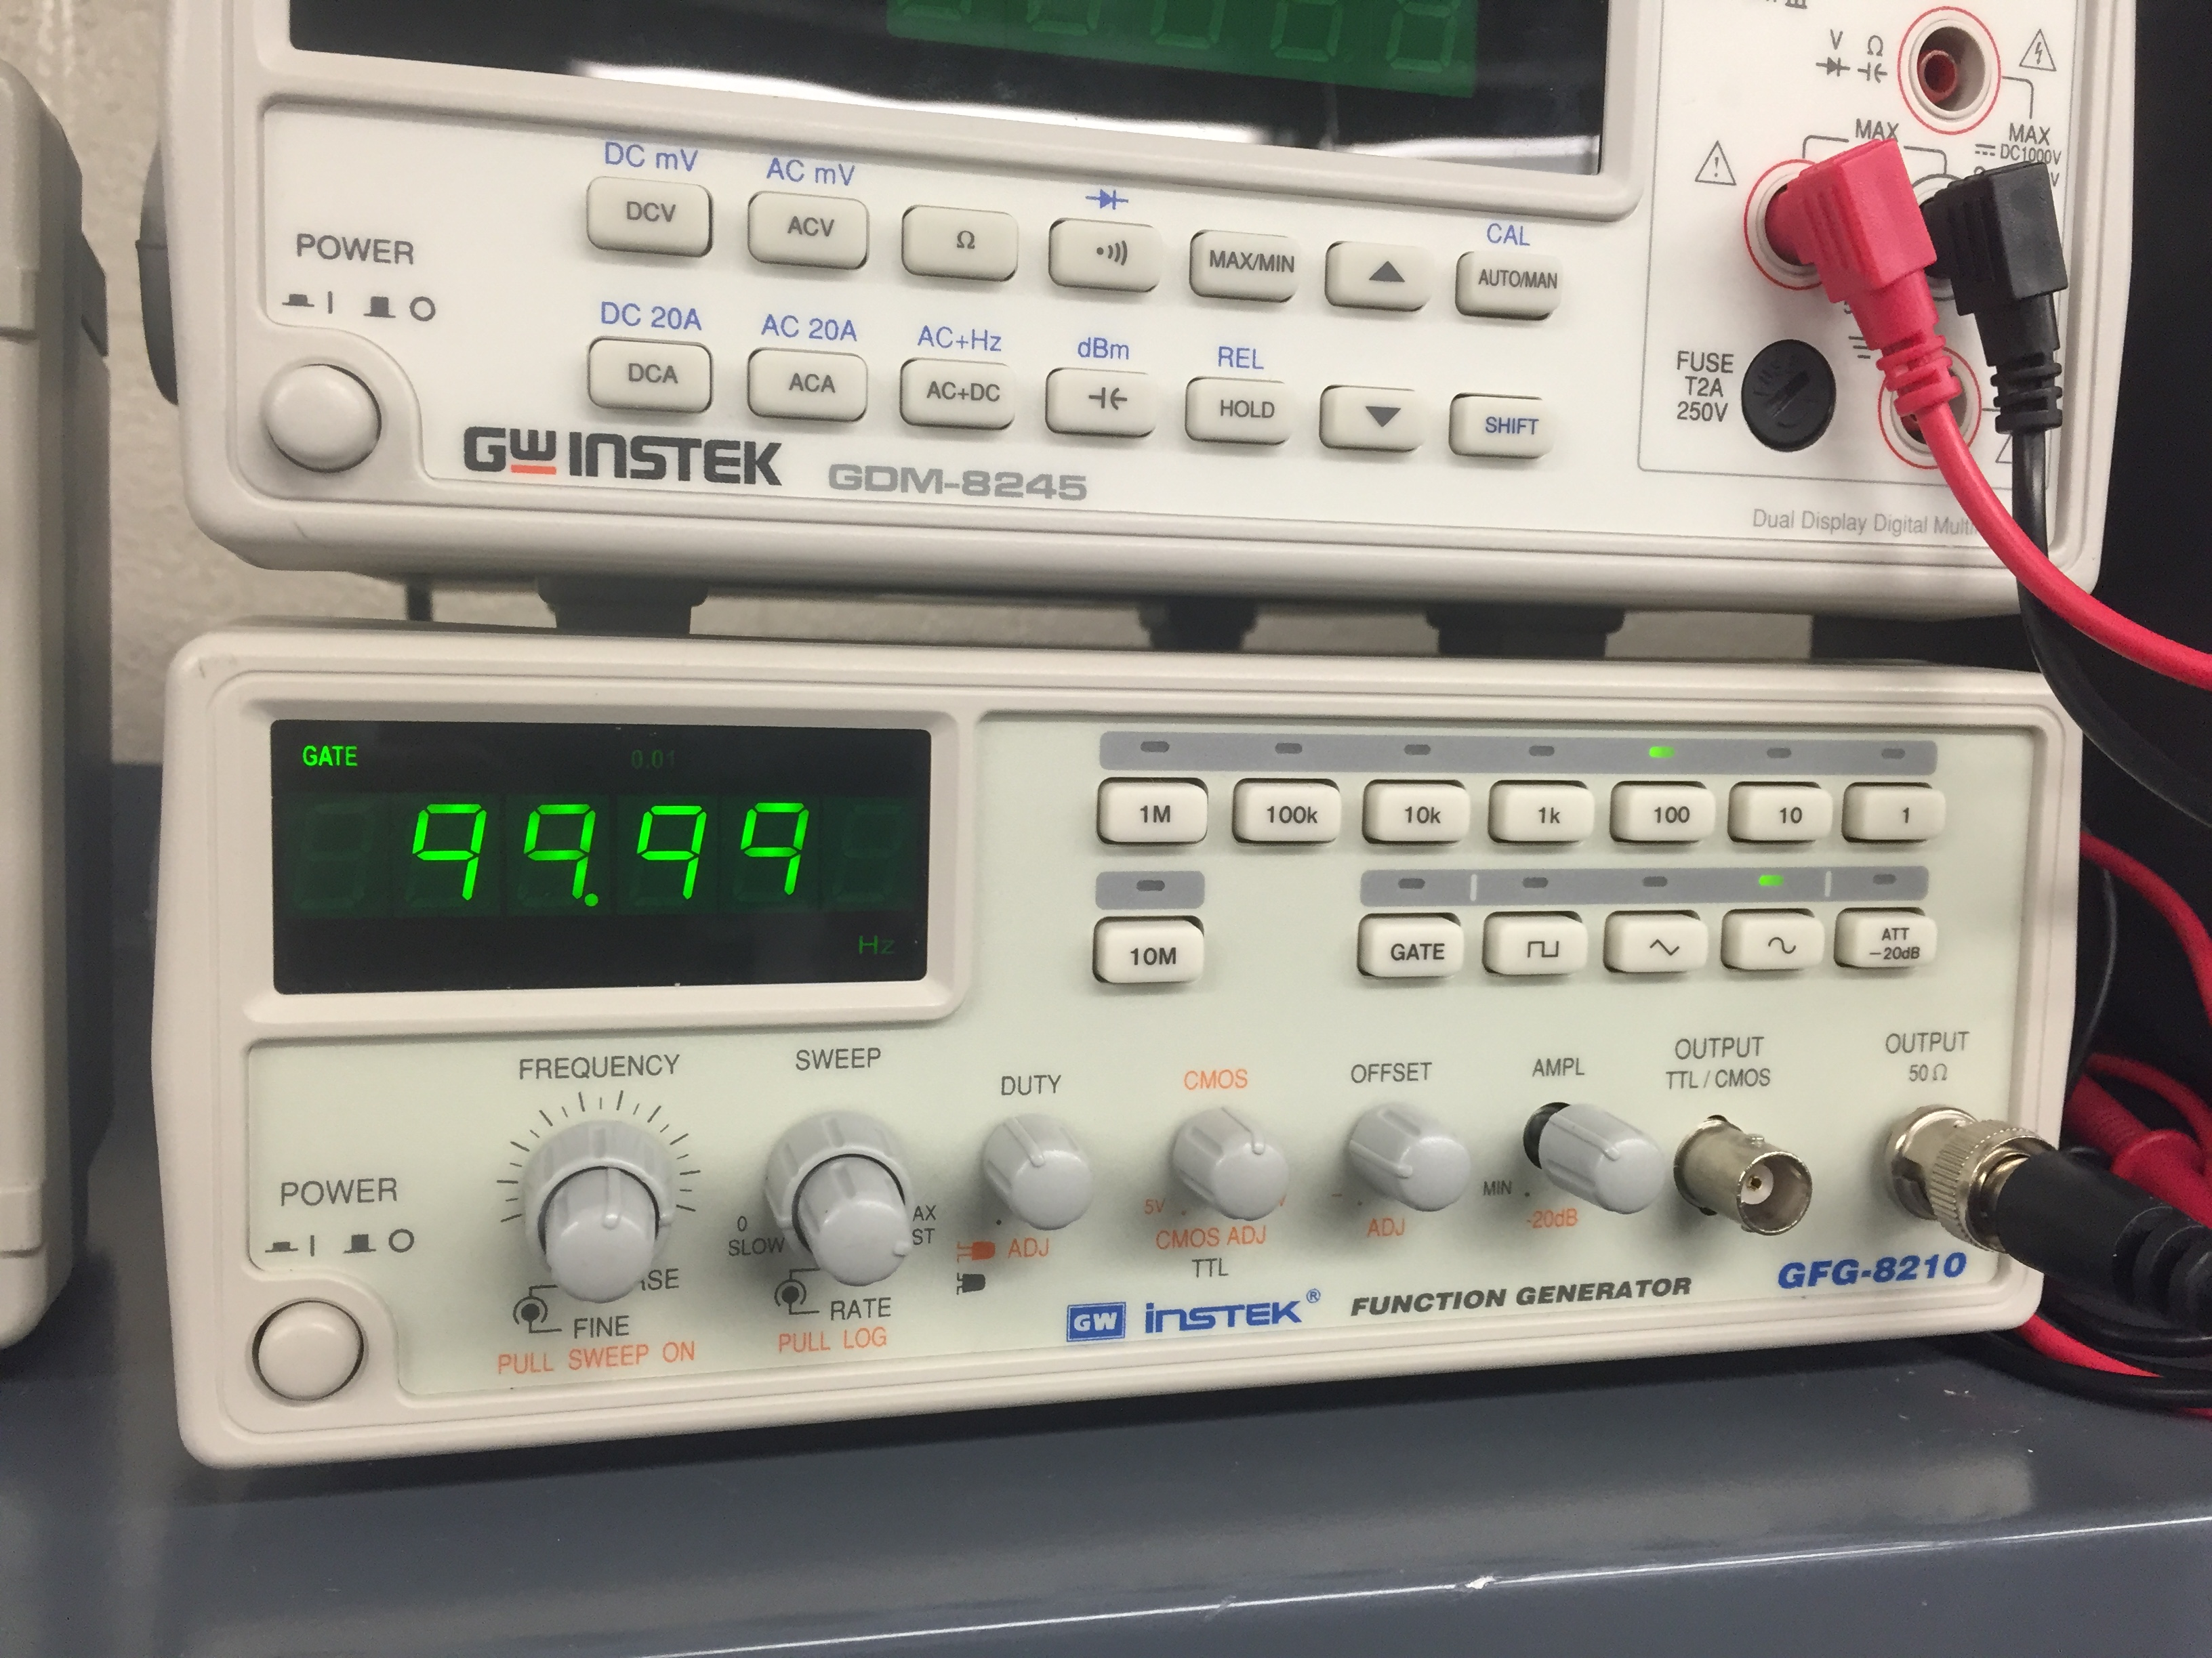
Lab F₁

Slide 16
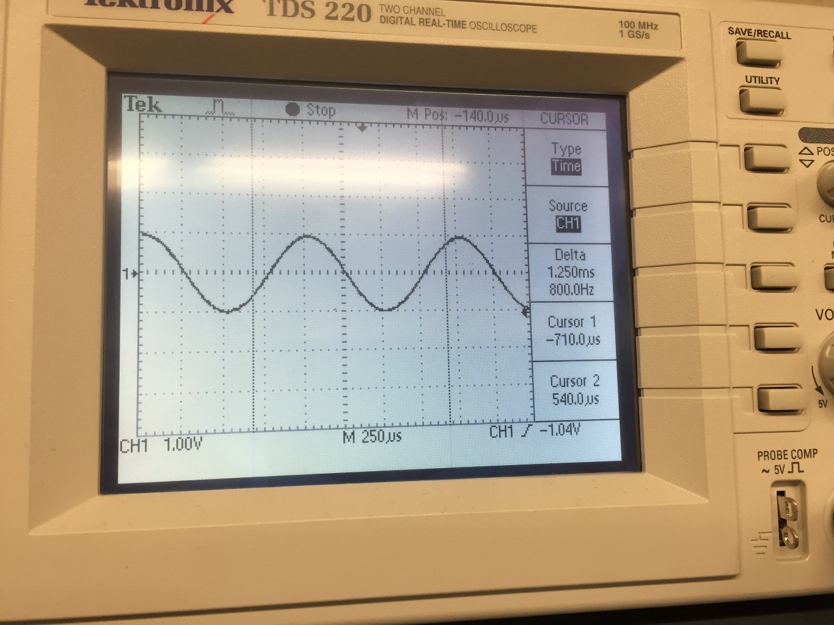
Lab F₁

Slide 17
Lab F₁
  Conclusion
  - All calculations and simulation correlated properly with the given experiment.

Slide 18
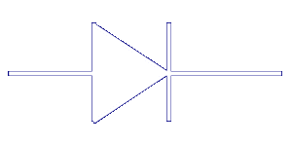
Lab 1 - Diodes
Week 4: 2/2/16

Slide 19
Lab 1 - Diodes
Purpose: To understand how to properly utilize a diode, and the different ways they are applied.
Equipment: * Bench 8
*Power Supply – HY1802D
* Multimeter – GDM 8245
*Oscilloscope – TDS 220
Research & Information:
- Datasheets

Slide 20
Procedures
A diode and a resistor are hooked together in a series format.
After which measurements are taken and compared to Multsim Simulations.

Slide 21
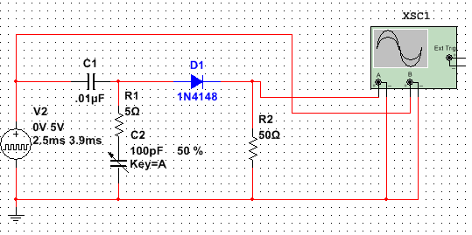
Multisim

Slide 22
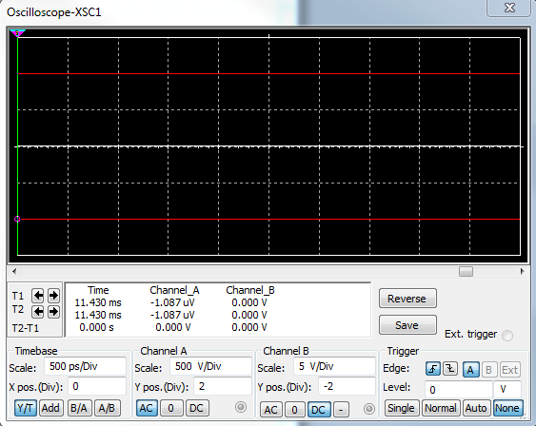
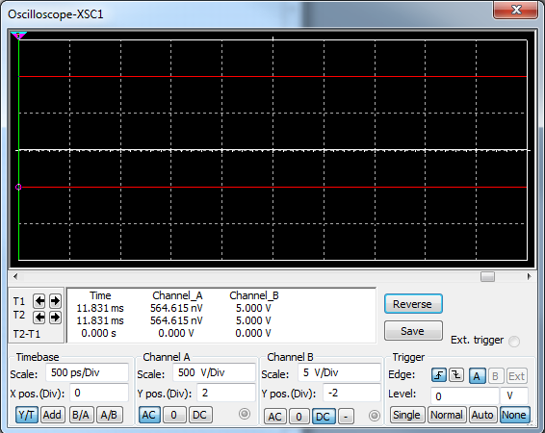
Multisim

Slide 23
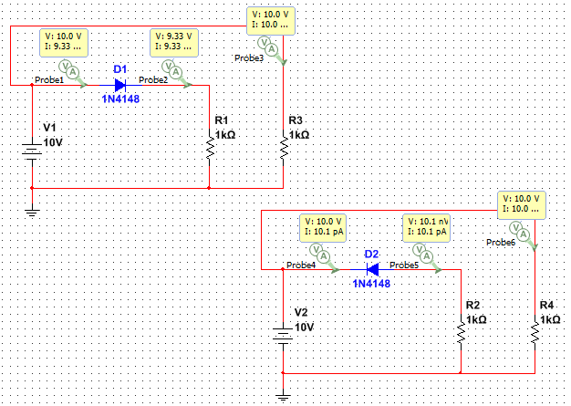
Multisim
Reverse
Forward

Slide 24
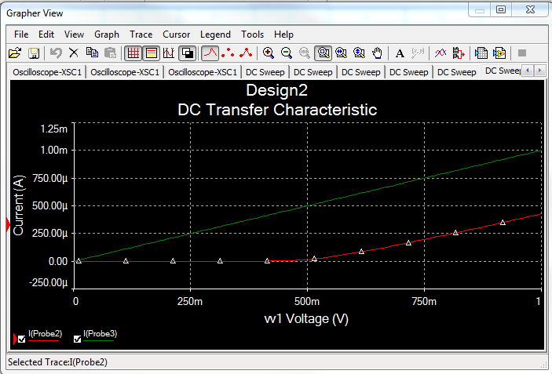
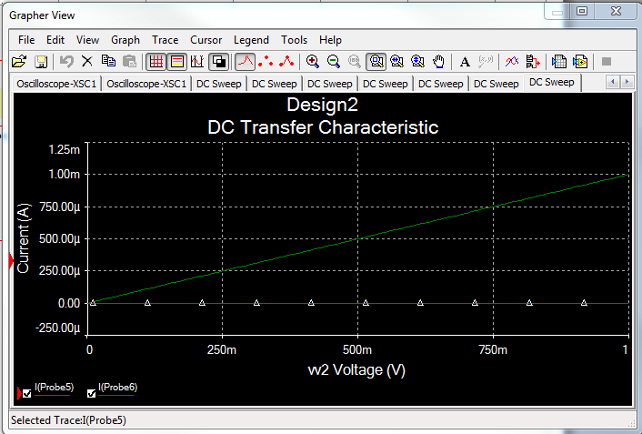
Multisim
Standard
Reverse

Slide 25
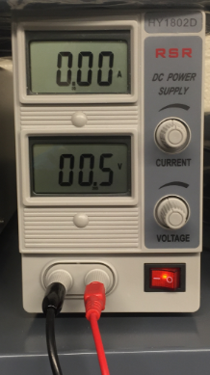
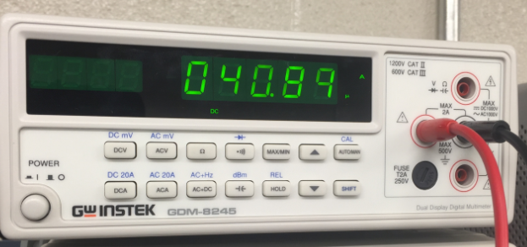
Pictures

Slide 26
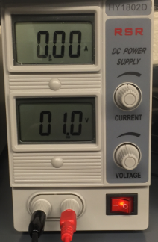
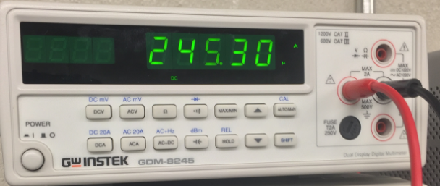
Pictures

Slide 27
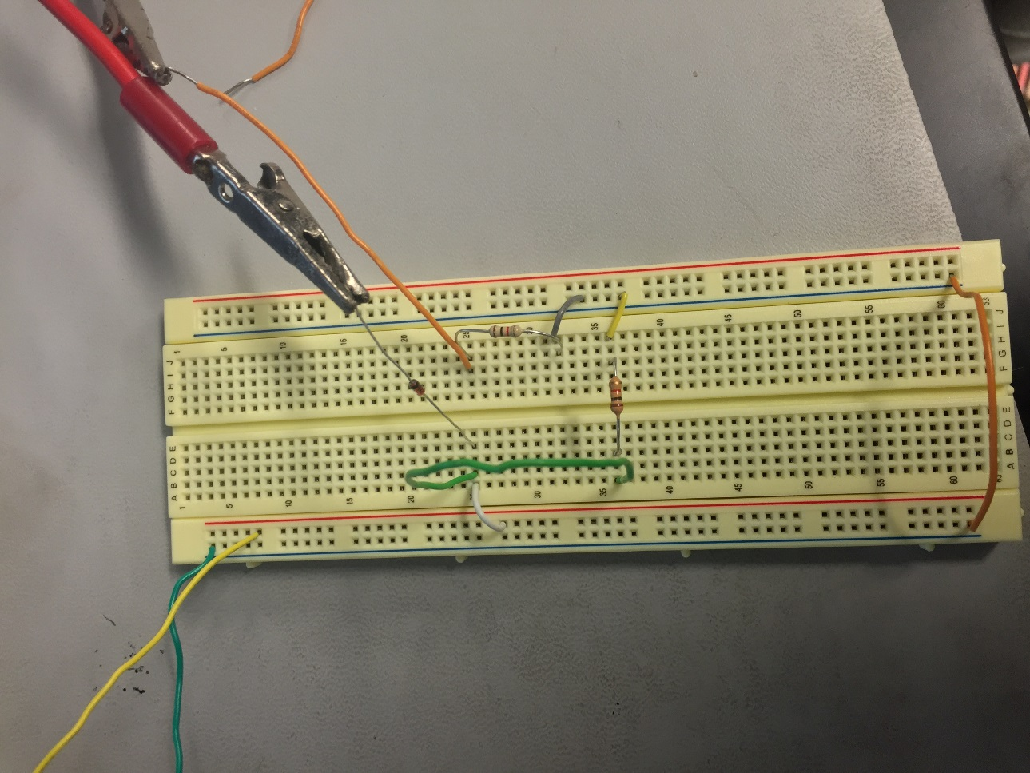
Pictures

Slide 28
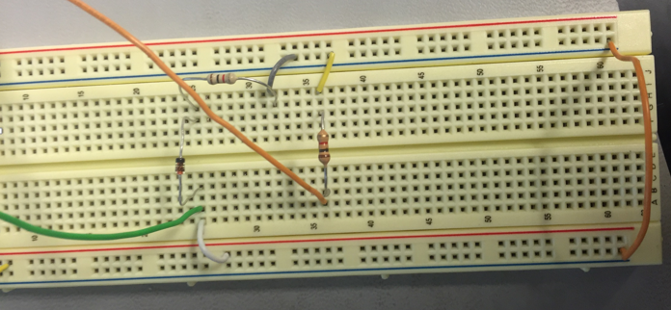
Pictures

Slide 29
Conclusion
All measurements taken coincided with the Multisim simulation's.
There were no issues with the hook up of the circuit.

Slide 30
Sources
http://www.nxp.com/documents/data_sheet/1N4148_1N4448.pdf (1n4148 DS)

Slide 31
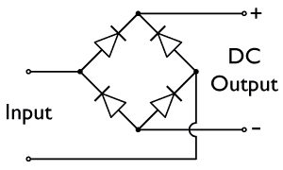
Lab 2 – Full and Half Wave Bridge
Week 4: 2/2/16

Slide 32
Lab 2 – Full and Half Wave Bridge
Purpose: To build wither a full wave bridge or a half way bridge. After building measurements art to be taken to prove whether or not the multisim simulation corresponds to the finished circuit.
Equipment: * Bench 8
*Oscilloscope: TDS 220
*Multimeter: GFG-8210
Research & Information:
- Datasheets

Slide 33
Procedures
Four Diodes are hooked together to form a full wave pattern.
Following this a transformer is also attached.
Measurements are taken from different points on the full wave bridge.

Slide 34
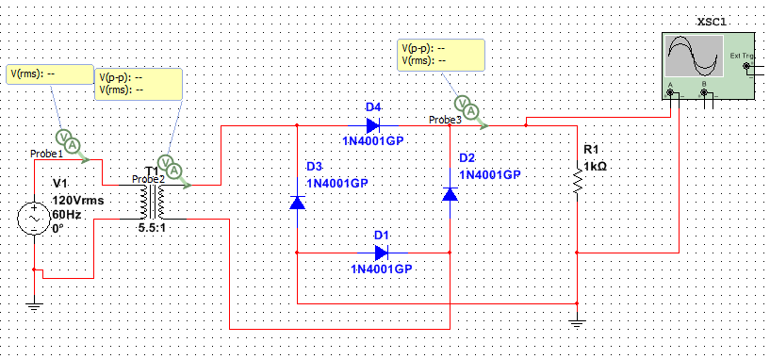
Multisim
Full Bridge

Slide 35
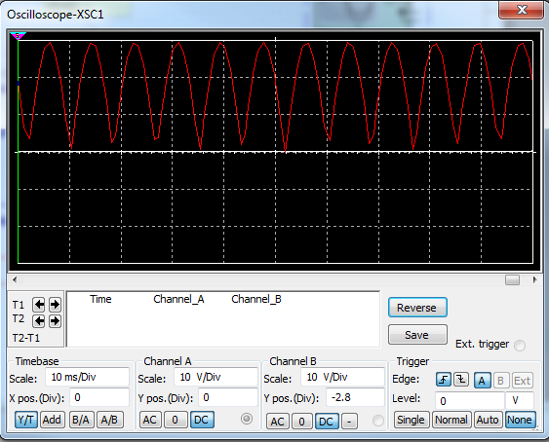
Multisim
Oscilloscope

Slide 36
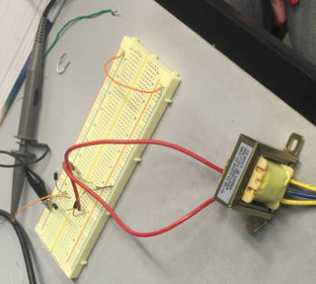
Pictures

Slide 37
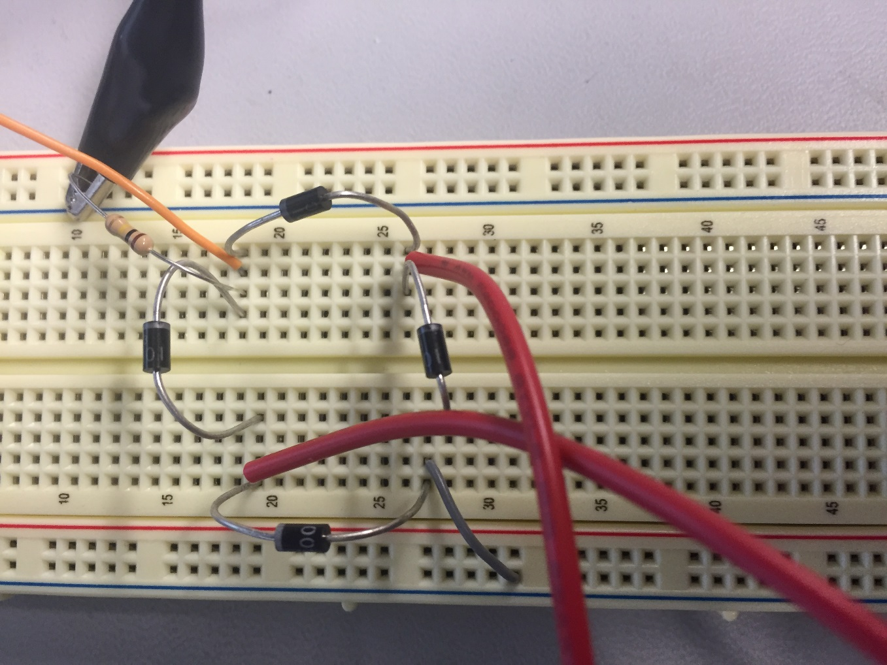
Pictures

Slide 38
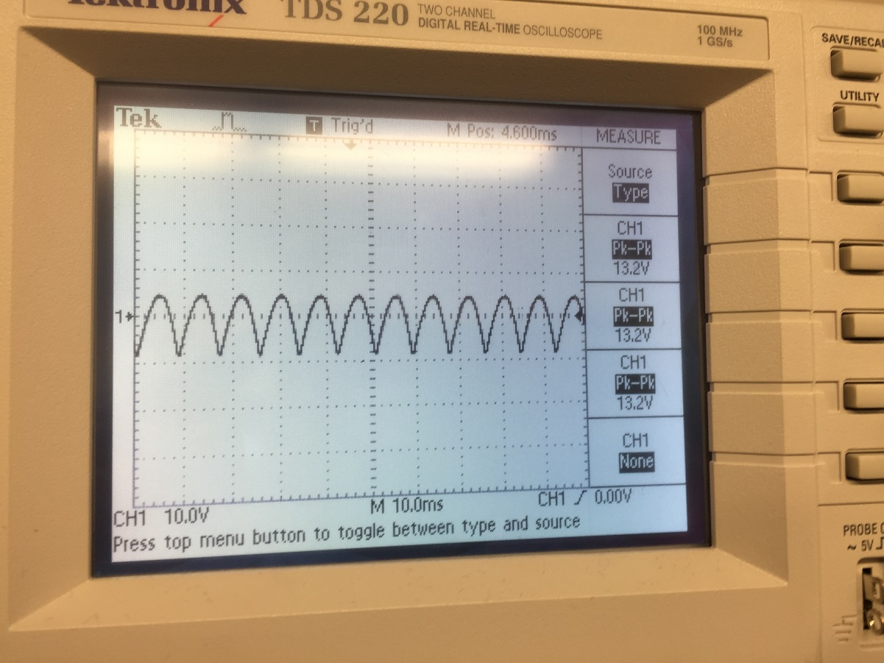
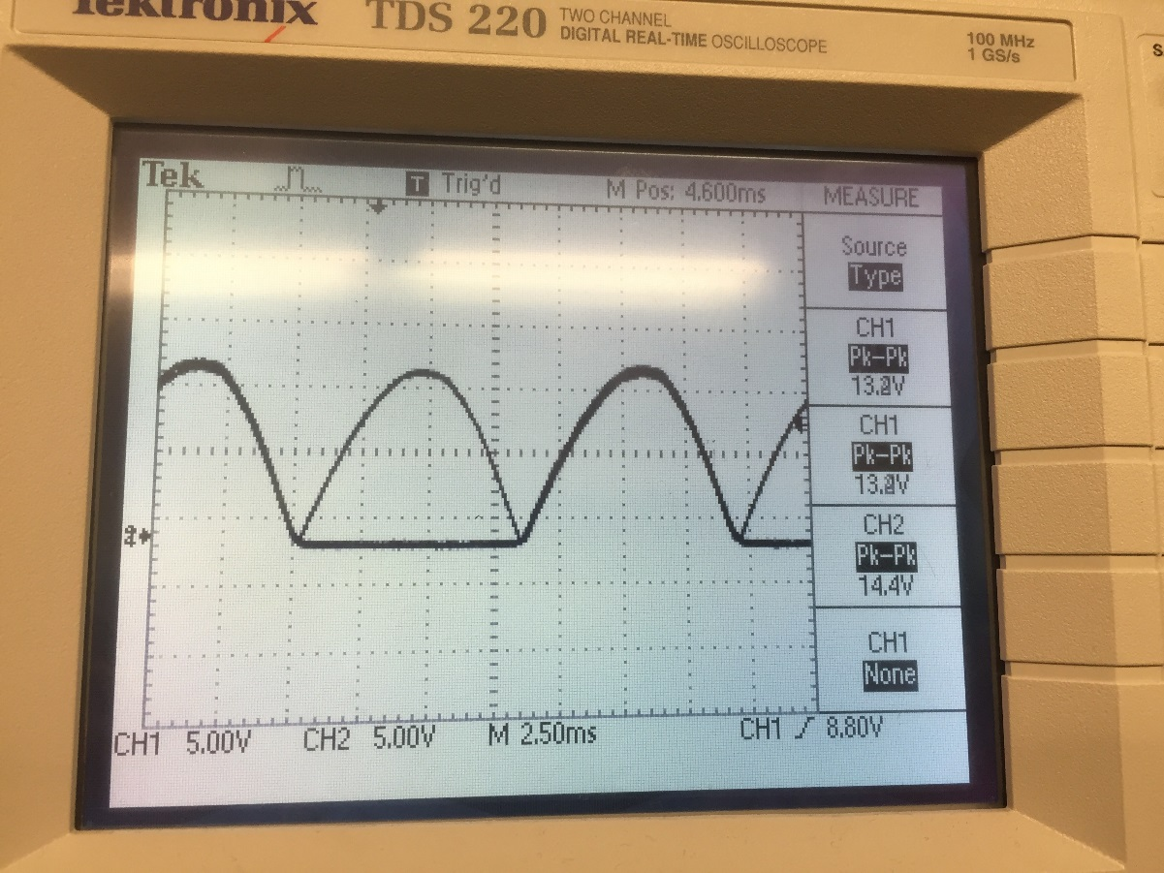
Pictures

Slide 39
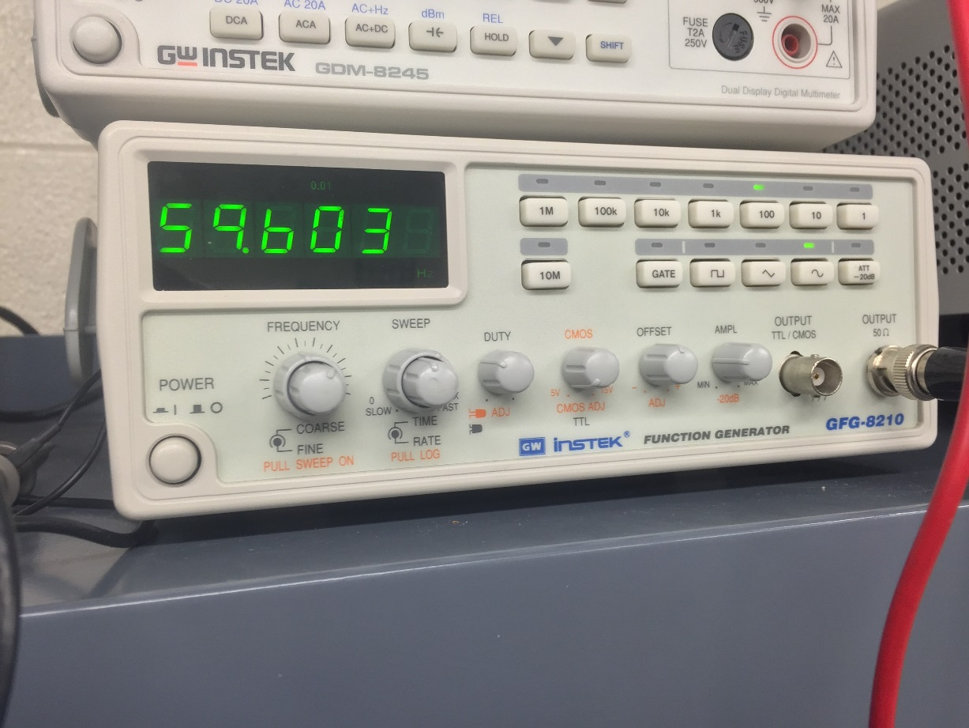
Pictures

Slide 40
Conclusion
Everything worked according to the schematic. Although this was my first time working with a transformer it was not hard to hook up.

Slide 41
Sources
http://www.diodes.com/_files/datasheets/ds28002.pdf (1N4001 DS)

Slide 42
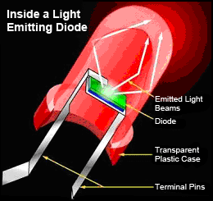
Lab 3 – LED’s
Week 4: 2/2/16

Slide 43
Lab 3 – LED’s
Purpose: To test which LED’s will work best when a specific resistor and voltage value are selected.
Equipment: * Bench 8
*Multimeter: GDM-8425
Research & Information:
- Datasheets

Slide 44
Procedures
Select many different types of LED’s to experiment with.
Each LED will be put in series with a specific resistor and voltage in mind to find the brightest LED.

Slide 45
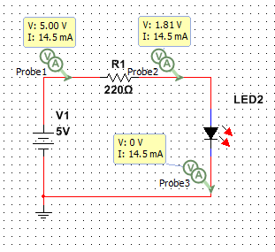
Multisim

Slide 46
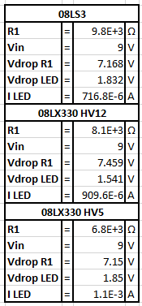
Excel

Slide 47
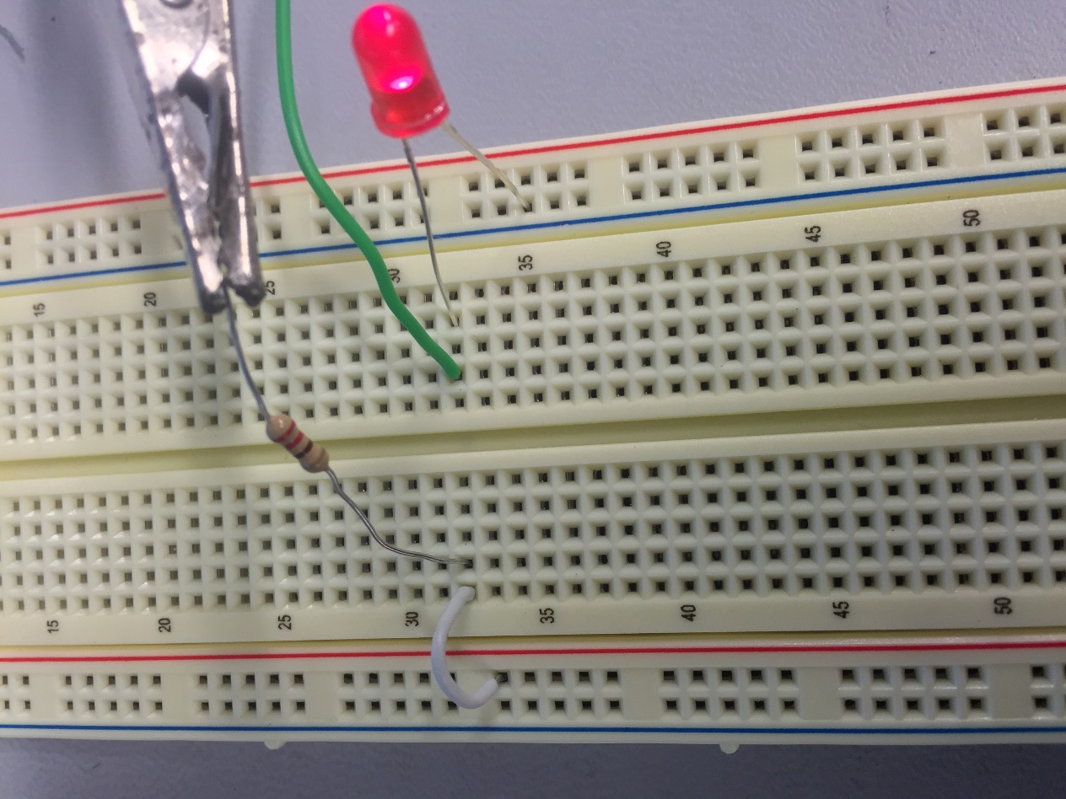
Pictures

Slide 48
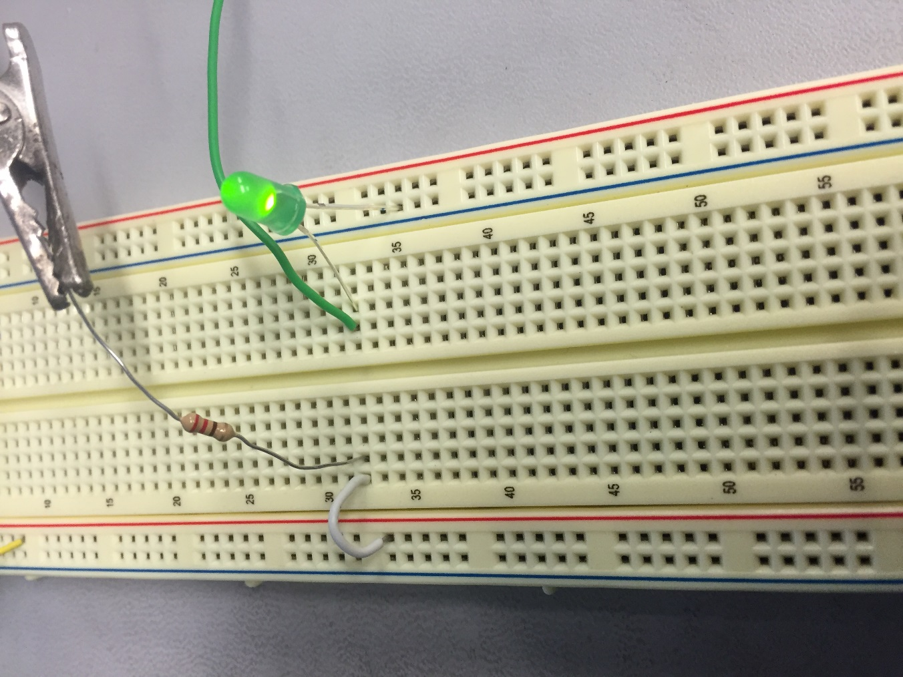
Pictures

Slide 49
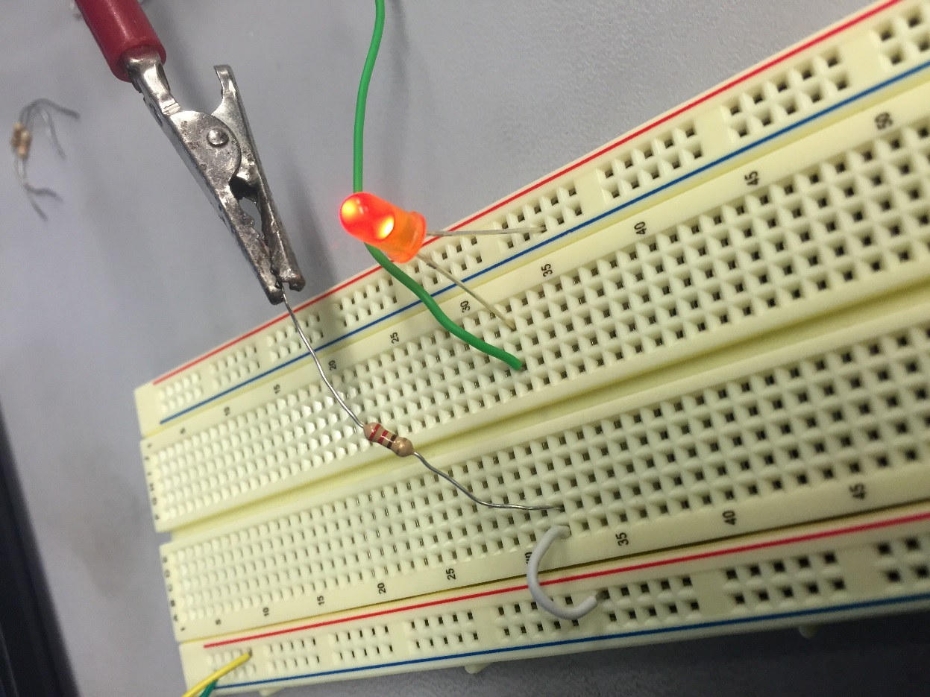
Pictures

Slide 50
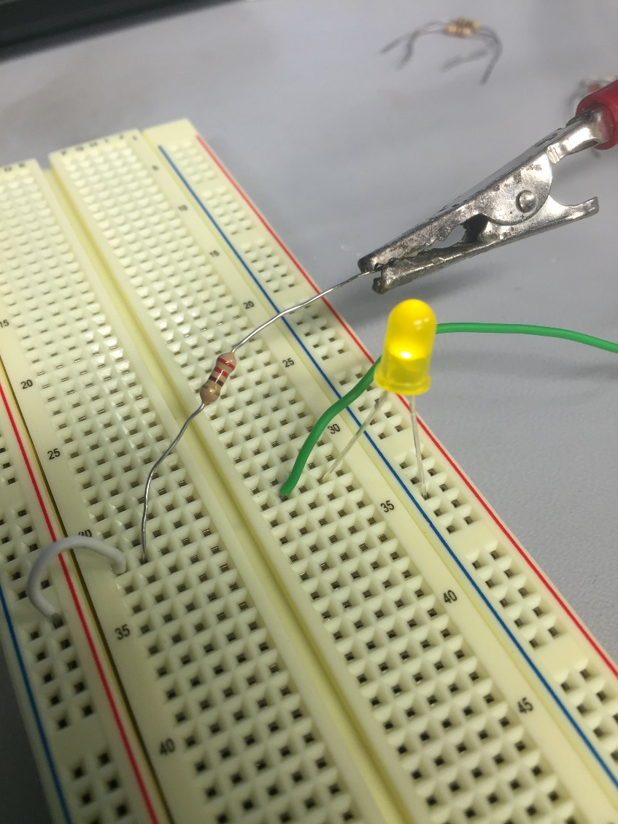
Pictures

Slide 51
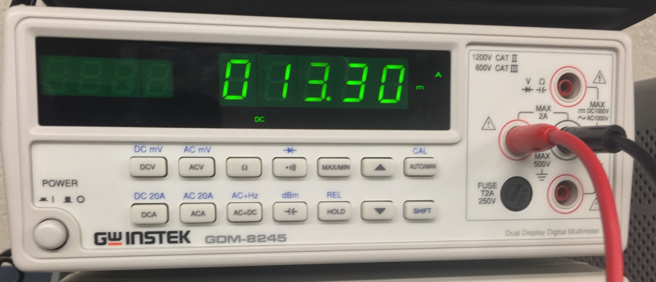
Pictures

Slide 52
Conclusion
Everything worked well, as it turns our brightness is by point of view. An LED may look dim when looking at it from the side, and yet looking at it from the top it can look to be extremely bright.
In the end 08LS3, was the LED chosen.

Slide 53
Sources
http://www.datasheet4u.com/html/T/L/U/TLUR6400_VishayTelefunken.pdf.html (LED DS)

Slide 54
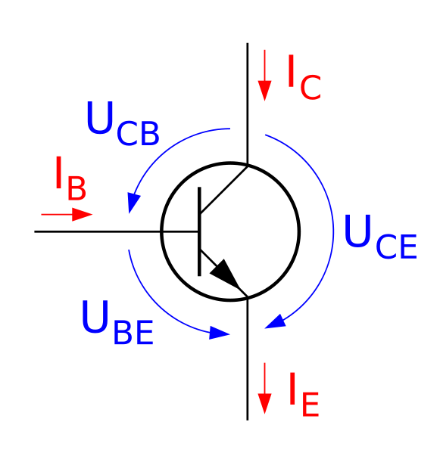
Lab 4 - +/- 9V Power Supply
Week 7: 2/23/16

Slide 55
Lab 4 - +/- 9V Power Supply
Purpose: To design a plus and minus 9 volt power supply. After the designing process is complete parts are to be ordered and then built on a solder board.
Equipment: * Bench 8
*Oscilloscope: TDS 220
*Multimeter: GFG-8210
Research & Information:
- Datasheets

Slide 56
Procedures
A + and – 9 volt power supply is to be designed using multisim.
After design is confirmed parts are to be ordered from RSR.
Once parts arrive they are to be soldered to a board and tested.

Slide 57
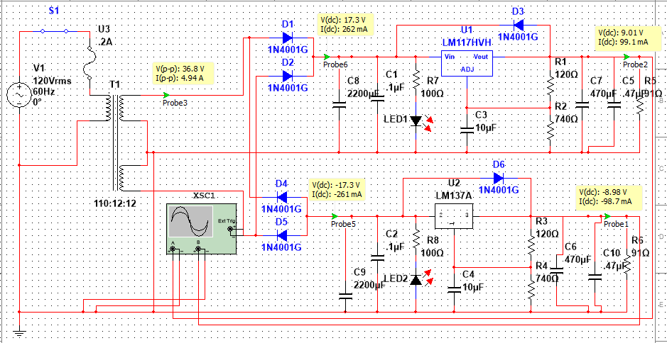
Multisim

Slide 58
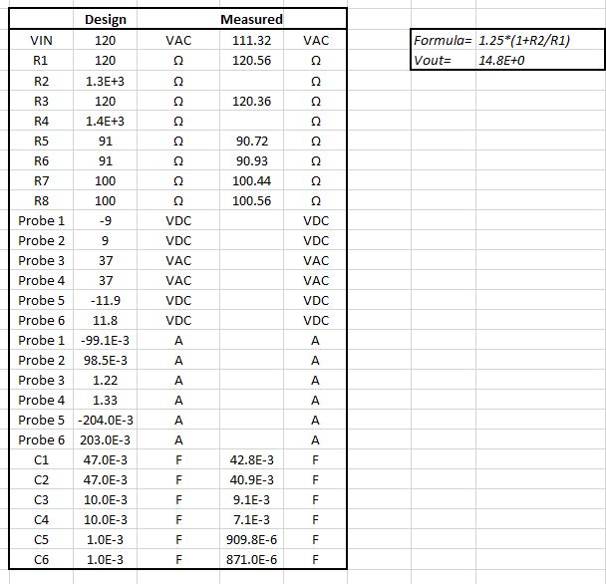
Excel

Slide 59
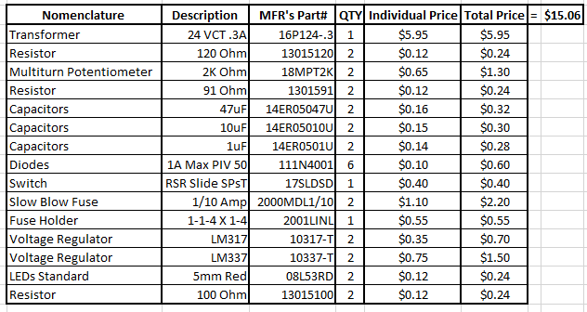
BOM - Original

Slide 60
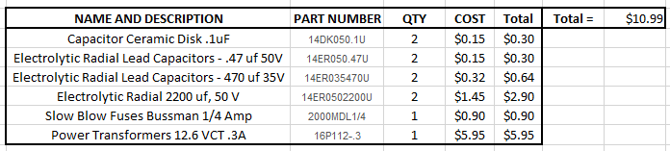
BOM - Revised

Slide 61
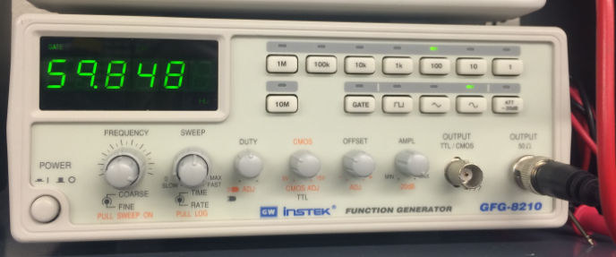
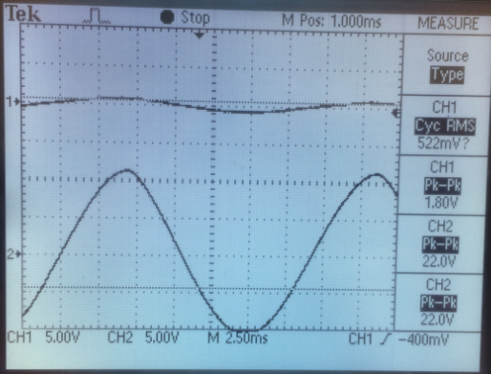
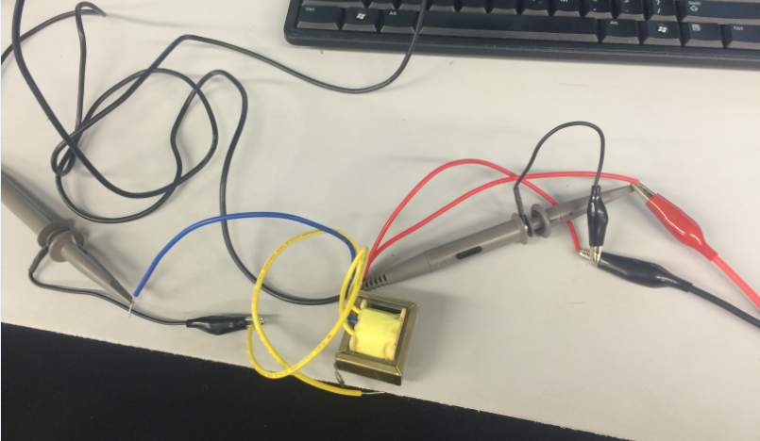
Pictures – Testing

Slide 62
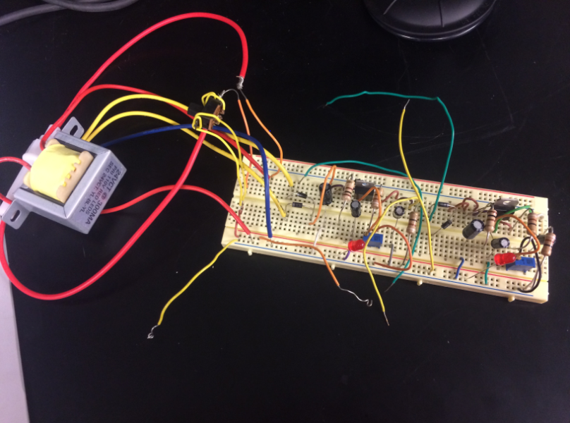
Pictures – Testing

Slide 63

Pictures – Result

Slide 64

Pictures – Result

Slide 65
Conclusion
Although the design itself was not difficult to come up with, it was the values of particular parts which caused an issue. However, good values were eventually calculated.
When soldering the parts to the bored for the first time, my partner and I were not aware that some of the outside strips were connected. However, this issue was remedied without undoing the entire circuit.
My partner and I were successfully able to get a good reading from the positive side of the circuit, however the negative side was no functioning the way we had hoped.

Slide 66
Sources
http://www.datasheet4u.com/html/T/L/U/TLUR6400_VishayTelefunken.pdf.html (LED DS)
http://www.ti.com/lit/ds/symlink/lm137.pdf (LM337)
http://www.ti.com/lit/ds/symlink/lm117.pdf (LM317)

Slide 67
Lab 5 – NPN LED Switch 5V+ 9V

Slide 68
Lab 5 - NPN LED Switch 5V+ 9V
Purpose: To design a circuit which will cause and LED to flash at a particular voltage with specific requirements designated by the instructor.
Equipment: * Bench 8
    Oscilloscope TDS 220
    Function Generator GFG-8210
Research & Information:
Datasheets
Multisim

Slide 69

Multisim

Slide 70

Pictures

Slide 71


Pictures

Slide 72

Video

Slide 73

Pictures

Slide 74
Conclusion
The experiment was a success, getting the LED to flash with aid of the NPN worked as the schematic stated.

Slide 75
Lab 6 – CE Transistor

Slide 76
Lab 6 - CE Transistor
Purpose: To create a circuit for CE Transistors following the seven steps as presented by the instructor.
Equipment: * Bench 8
    Oscilloscope TDS 220
    Function Generator GFG-8210
Research & Information:
- Datasheets

Slide 77

Multisim – Step 2

Slide 78

Multisim – Step 1

Slide 79

Multisim – Step 1

Slide 80

Multisim – Step 2

Slide 81

Multisim – Step 3

Slide 82

Multisim – Step 3

Slide 83

Multisim – Step 4

Slide 84

Multisim – Step 4

Slide 85

Multisim – Step 5

Slide 86

Multisim – Step 5

Slide 87

Multisim – Step 6

Slide 88

Multisim – Step 7

Slide 89

Multisim – Step 7

Slide 90

Multisim – Collector Current Curve

Slide 91

Multisim – Collector Current Curve

Slide 92

Excel – Collector Current Curve

Slide 93

Excel - Measurements

Slide 94

Excel – Step Voltages

Slide 95


Pictures

Slide 96
Conclusion
Everything worked according to all excel calculations and multsim simulations

Slide 97
Lab 7 – NPN LED Switch 2N2457

Slide 98
Lab 7 - NPN LED Switch 2N2457
Purpose: To create and understand NPN LED switch circuit by using 2N2457
Equipment: * Bench 8
    Oscilloscope TDS 220
    Function Generator GFG-8210
Research & Information:
- Datasheets

Slide 99

Multisim

Slide 100

Multisim - Sweep

Slide 101

Multisim - Sweep

Slide 102

Multisim - Transconductance

Slide 103


Pictures

Slide 104
Conclusion
Everything worked according to the simulation created in multisim, there were no issues hooking up the circuit.

Slide 105
Lab 8 – CE Transistor 2N5457

Slide 106
Lab 8 - CE Transistor 2N5457
Purpose: To design a CE transistor circuit using multisim with the transistor model being a 2N5457.
Equipment: * Bench 8
    Oscilloscope TDS 220
    Function Generator GFG-8210
Research & Information:
- Datasheets

Slide 107

Multisim

Slide 108

Multisim

Slide 109

Multisim

Slide 110

Multisim – DC Sweep

Slide 111

Multisim – AC Sweep

Slide 112

Excel – Transfer Characteristic

Slide 113

Excel – Measured

Slide 114
Conclusion
All calculations and simulations agreed with one another.
Learned why a load line is something important to have.

Slide 115
Lab 9 – Filter Design

Slide 116
Lab 8 - CE Transistor 2N5457
Purpose: To build a high-pass, low-pass and band-pass filter using a butterworth design.
Equipment: * Bench 8
    Oscilloscope TDS 220
    Function Generator GFG-8210
Research & Information:
Datasheets
Multisim

Slide 117

Multisim – High pass

Slide 118

Multisim – High pass

Slide 119

Multisim – Low pass

Slide 120

Multisim – Low pass

Slide 121

Multisim – Band pass

Slide 122

Multisim – Band pass

Slide 123

Excel

Slide 124
Conclusion
All calculations corresponded with the results found in multisim.
There were no issues in hooking up the circuit or finding equations.

Slide 125
How to Find 2.5x Original Va
Olivia Koehler
EECT 121-50c
1\19\16

Slide 126
Table of Content
Objective Pg. 3
What is the value needed? Pg. 4
What parts can be changed? Pg. 5
How to change those parts Pg. 7
End result Pg. 8

Slide 127
Objective
- To manipulate the original circuit in such a way, so the new Va is 2.5x greater then original.
NOTE: No other V values should change, besides the value of Va.

Slide 128


What is the value needed?
Start Here
Multiply this Va value by 2.5
2.5*(.345) = .8625
Locate Va, which equals 345 mV or .345 V

Slide 129


What parts can be changed?
Because no other V value can be changed but Va, that only leaves 2 possible parts which can be changed.
The RT of R6 and R7 must stay the same; if it changes the values of Va and Vb will change,
this is because they are in parallel with one another.

Slide 130


What parts can be changed?
These two parts are in series with one another, that means their combined RT has to stay the same. However, the values
of the resisters themselves can be changed as long as the RT is not altered.

Slide 131

How to change those parts
Using the Voltage Divider Rule, the new resistance values can be found.
Using the new Va value and multiplying it by the RT of R6 and R7 then dividing it by Vb the new R7 value can be determined.
For R6 simply subtract the new R7 value from the original RT of the two resistors.
R7
R6
(.862*(11000))/3.79
11000-8500

Slide 132


End Result
After changing R6 and R7 to their new values the new desired Va can be found.
Notice no other voltage values have changed, except for Va.

Slide 133

End Result
Before
After
Thusly, Va can be changed without changing any other voltage values in the circuit.

Slide 134
Supplementary Lessons
Weeks 1-17

Slide 135
Week 1

Slide 136


Week 1
Part 1: Build a circuit with the corresponding values to sample circuit given by professor.
Professors
Mine

Slide 137

Week 1
Excel

Slide 138


Week 1
Part 2: Modify the circuit so that Va = 2.5x that of the original Va.
Before
After

Slide 139
Week 1
Excel

Slide 140


Week 1
Part 3: Determine the wattage value needed for each part.

Slide 141

Week 1
Excel

Slide 142

Week 1
Part 4: Redesign the circuit using only 1k resistors for the original circuit.

Slide 143


Week 1
Part 4: Redesign the circuit using only 1k resistors for the original circuit.
Sub 1
Sub 2

Slide 144
Week 1
Part 4: Redesign the circuit using only 1k resistors for the original circuit.
Sub 3

Slide 145

Week 1
Excel

Slide 146



Week 1
Excel

Slide 147


Week 1
Excel

Slide 148
Week 2

Slide 149

Week 2
Part 1: Using the original circuit from Lab 1, determine Va Variation using 5% resistors.

Slide 150
Week 2
Part 1: Using the original circuit from Lab 1, determine Va Variation using 5% resistors.

Slide 151

Week 2
Simulations

Slide 152

Week 2
Simulations

Slide 153

Week 2
Simulations

Slide 154

Week 2
Excel

Slide 155


Week 2
XC Calculations
XL Calculations

Slide 156
Week 3

Slide 157
Week 3
Simulations

Slide 158
Week 3
Simulations

Slide 159

Week 3
Excel

Slide 160
Week 5

Slide 161

Week 5
Step 7

Slide 162

Week 5
Step 7

Slide 163

Week 5
Step 7

Slide 164



Week 5
Step 8

Slide 165

Week 5
Voltage

Slide 166
Week 6

Slide 167
Week 7

Slide 168

Week 5
Original BOM

Slide 169
Week 8

Slide 170
Week 9
Spring Break – No Class

Slide 171
Week 10

Slide 172

Week 5
Revised BOM

Slide 173

Week 5
Datasheet

Slide 174
Week 11
See Labs 5 & 6

Slide 175

Week 11

Slide 176
Week 12

Slide 177
Week 12
My partner was out and we were to build power supplies, however because my partner was not there my instructor did not want me building with out him. Instead, I watched my fellow classmates build their power supplies and learned from them.
Some calculations were made in order to find a new resistor value for the LED.

Slide 178

Week 12

Slide 179
Week 14

Slide 180

Week 14

Slide 181

Week 14

